Slide 1



1rx.ai
One Link
Application

Slide 2
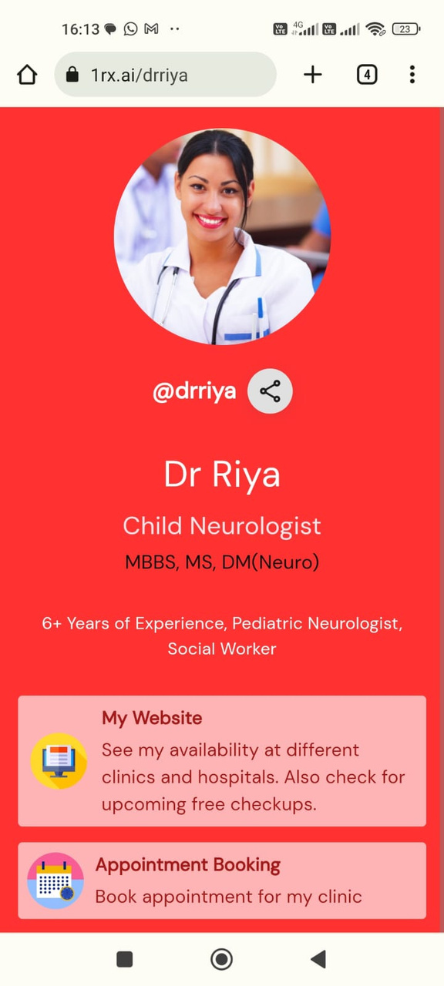
INTRODUCTION
Elevate your digital presence effortlessly with 1rx.ai. Experience the swift launch of your personalized healthcare hub using our intuitive link-builder.
Providing right information with an Impact
240% more Engagement
Reduces information overload

Slide 3


  Too much information on the internet.
  The shorter attention span of the visitors.
  Demand for precise information.
PROBLEM
  Doctors creating contents, but not able to index it
  Searching, Sorting and Sharing of Content
  Link tracking
PROBLEM

Slide 4

1rx.ai
1 Link Application
A home to all your important links
SOLUTION

Slide 5
UNIQUE SELLING POINTS
1 Unified Link
Streamlined Content Organization
Centralized platform for healthcare professionals to manage their digital presence.
Secure and organized location for uploading and managing medical content.
Personalized Digital Profiles
Enhanced Patient Experience
Customizable profiles that reflect the identity of healthcare professionals
Improved engagement and access to healthcare services for a positive patient experience
  Multi-Link Capabilities
  Simple and Clean UI
  Time-Saving Solution
  Mobile Responsiveness
  Integration with Social Media
  Patient Groups
Effortless Resource Sharing
One-click sharing of educational content and resources for improved health literacy

Slide 6

PRODUCT FEATURES
Share all your links in one place
Get Discovered
Create and Manage your community in one place
Track Link views
Show your latest content automatically
Sell your Services/Products from your page
Analyze each content

Slide 7
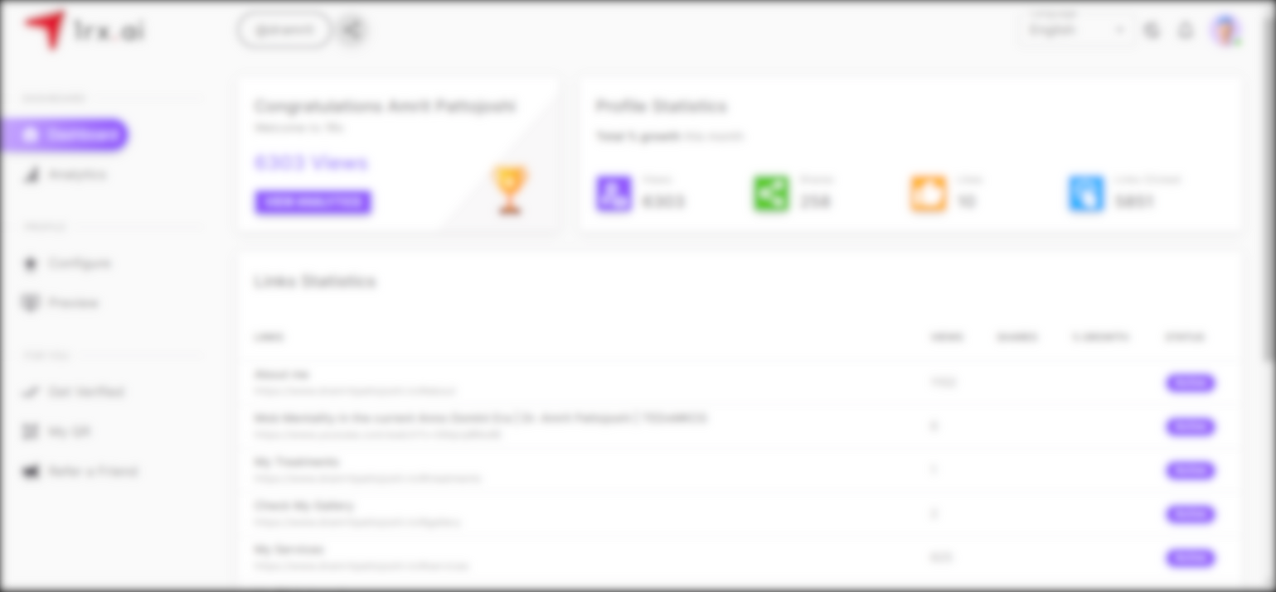
Get started in Minutes. Easy, Interactive and Intuitive UI
Admin dashboard to manage all links at ease
HOW IT WORKS?

Slide 8

GET STARTED
  Sign up from 1rx.ai homepage
  Customize Your Profile
  Upload Content and Links
  Explore Themes and Customizations
  Share your Link
  Customize link anytime
  Track link Performance

Slide 9
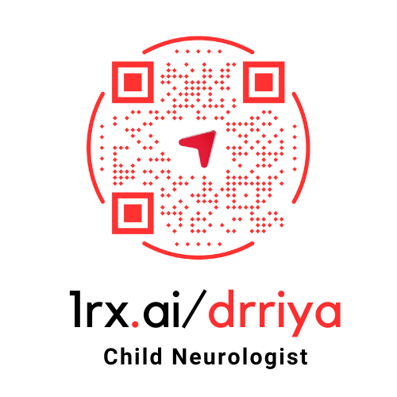
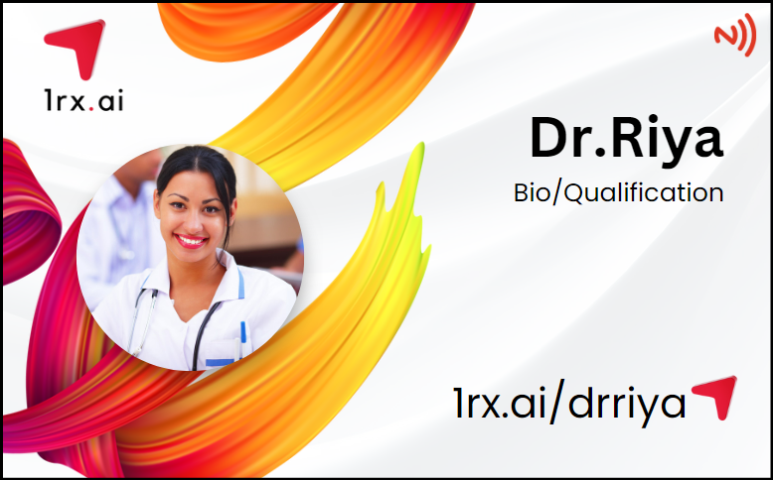
  Get Verified
  Generate QR Code
  Get NFC Card

Slide 10




USE CASES
Individual Doctor Link
Ailment/Disease/Treatment Link
Hospital/
Diagnostics Center/
Pharmacy Links
Clinic Link
Event Link
Campaign Conversion Pages/Link
Surgery/
Procedure Link
Medicine Link

Slide 11
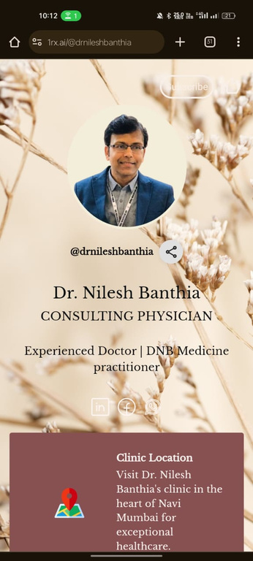
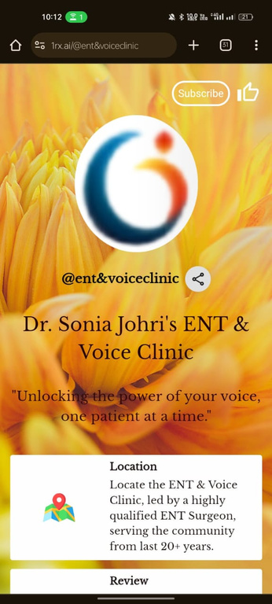
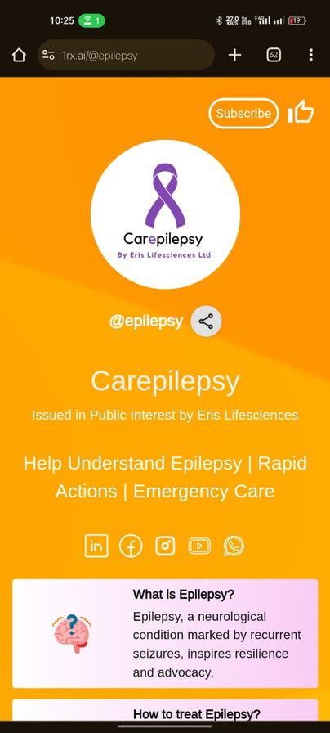
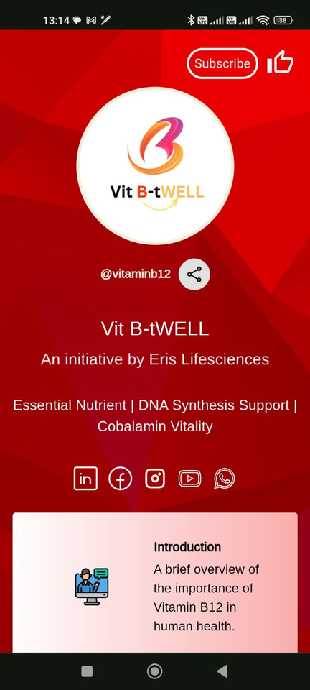




SAMPLE LINKS

Slide 12

ADVANTAGE FOR DOCTOR
  Streamlined Access to Information
  Enhanced Online Presence
  Promotion of Services / Treatments
  Social Media Integration
Direct Appointment Scheduling
Patient Education, Awareness & Engagement
  Emergency Contact Information
  Easy Accessibility
  Analytics and customization

Slide 13
BENEFIT FOR PHARMA COMPANIES
1 PRODUCT MULTIPLE ENGAGEMENT
EASY OPERATION, QUICK DELIVERY
COST EFFECTIVE AND MEASURABLE ROI
Real-time Updates
  Single Click Content Push
  Educational Resources
CONVENIENCE FOR DOCTORS
  Increased Product Visibility
  Targeted Marketing
  Enhanced Information Sharing
Data Analytics & Insights
Improved Patient Outcomes.
Patient-Centric Campaign

Slide 14

PRICING
INR 1999
Minimum Order Quantity - 100
/link/year
BASIC
PLAN
Offer Price
INR 999
Till 31 December 2023
/link/year
ENTERPRISE PLAN
CUSTOM PRICING
Admin Dashboard
Detailed Analytics
24/7 dedicated
customer support.
On-site
training options.
(Contact us for a Quote)
Prices are valid for DIY Application, Support Charges may apply in case of “Done For You” Scenarios

Slide 15

MERCHANDISE PRICING
Acrylic Standee with Custom QR Stickers
Minimum Order -100
One Delivery Location
QR STANDEE
INR 299
PVC NFC Card with custom Design
Minimum Order -100
One Delivery Location
INR 249
NFC CARD
ENTERPRISE PLAN
CUSTOM PRICING
  For More than 500 Units
  Door Step Delivery
(Contact us for a Quote)

Slide 16



CONTACT US
www.1rx.ai
6th Floor, A Wing, Melange Towers, Hitec City, Hyderabad

