Slide 1






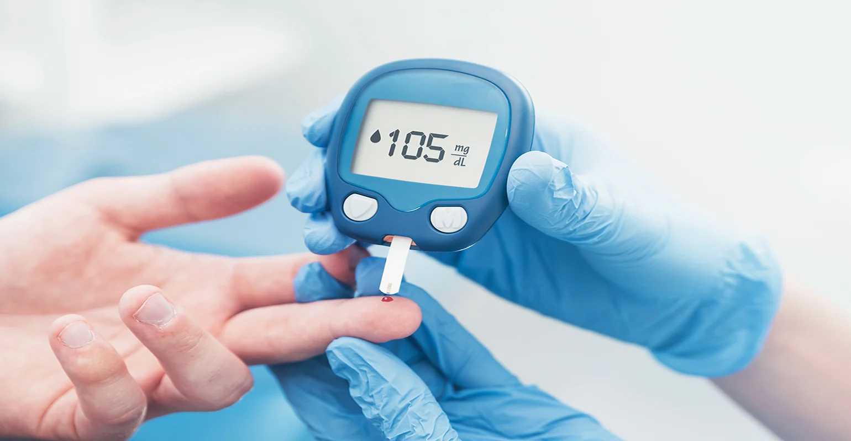
BRANDEX
SITAGLIPTIN
MARKET
STRATEGIES FOR PROMOTING BRAND WITH HELP OF AI
Rutuja Patil – P’MBA – IES MCRC
Harikesh Tiwari – P’MBA – IES MCRC
Rutuja Patil
Harikesh Tiwari

Slide 2
Brandex (Sitagliptin + Metformin)
1. DETERMINING BRANDS PURPOSE

Slide 3
1. BRAND PURPOSE
Brand purposes for pharmaceuticals, including those containing sitagliptin and metformin, often revolve around addressing specific medical needs and improving patient outcomes. Some common goals and purposes for these medications could include:
1. Blood Sugar Control: Many medications containing sitagliptin and metformin are prescribed to manage blood sugar levels in individuals with type 2 diabetes. The brand's purpose is be to provide an effective and reliable solution for maintaining glycemic control.
2. Patient Well-Being: Brands in the pharmaceutical industry often emphasize their commitment to improving the overall well-being of patients. This could involve not only controlling diabetes symptoms but also promoting a healthier lifestyle and minimizing potential side effects.
3. Innovation and Research: Some brands may highlight their commitment to research and innovation in diabetes management. This could involve ongoing efforts to develop new formulations, improve drug delivery mechanisms, or explore additional therapeutic benefits.
Traditionally- Start with your brand’s core mission and values
With AI & Apps- https://chat.openai.com/
Notes:
https://www.chameleon-pharma.com/services/pharma-regulatory-registration/Diabetes-regulatory-affairs/

Slide 4
1. BRAND PURPOSE
5. Patient Education: Brand purposes might extend to educating patients about the importance of medication adherence, lifestyle changes, and regular monitoring. This could involve creating educational materials, support programs, or online resources to empower patients in managing their condition.
6. Safety and Efficacy: Brands often emphasize the safety and efficacy of their medications. This includes rigorous testing, adherence to regulatory standards, and transparent communication about potential risks and benefits.
When comparing different brands, it's essential to consider factors such as formulation, dosage options, side effects, patient support programs, and pricing. The specific brand purpose and messaging may vary, so it's advisable to consult the latest information from the respective pharmaceutical companies or healthcare professionals for the most accurate and up-to-date details.
Traditionally- Start with your brand’s core mission and values
With AI & Apps- https://chat.openai.com/
Notes:
https://www.chameleon-pharma.com/services/pharma-regulatory-registration/Diabetes-regulatory-affairs/

Slide 5
Brandex (Sitagliptin + Metformin)
2. TARGETED AUDIENCE

Slide 6

2 KNOW YOUR AUDIENCE
Knowing your audience is crucial for any brand, including those in the healthcare industry.
Understanding the demographics, preferences, and needs of your target audience allows you to tailor your messaging, services, and overall brand strategy to better meet their expectations.
Building customer personas with basic detail and assumed behaviors such as major brand prescribed, influence of doctors, patient percentage, surveys and etc
TRADITIONAL APPROACH
With AI
Clearbit & hubspot offer AI-Driven insights, analyzing social media behavior and online transactions, brand support and influence, resulting in precise customer profiles

Slide 7




2. TARGETED AUDIENCE
Brandex is a combination drug used to treat type 2 diabetes. It combines sitagliptin a DPP-4inhibitor and metformin along with insulin sensitizer.
Target Audience: Adults with type 2 diabetes who have not been able to adequately control their blood sugar levels with metformin alone.
Brandex may also be appropriate for patients with type 2 diabetes who have Cardiovascular disease Chronic kidney disease Nonalcoholic fatty liver disease.
Diabeteologist
.
Endocrinologist
With AI reference info- https://bard.google.com/
Pharmacist
Notes:
https://www.chameleon-pharma.com/services/pharma-regulatory-registration/Diabetes-regulatory-affairs/

Slide 8
Brandex (Sitagliptin + Metformin)
3. MARKET SEGMENTATION

Slide 9
2. SOME MORE INFO
Diabetologist
.
Age: Janumet is typically used in adults aged 40-75 years old.
Gender: Janumet is used by both men and women.
Endocrinologist
With AI reference info- https://bard.google.com/
Pharmacist
Notes:
https://www.chameleon-pharma.com/services/pharma-regulatory-registration/Diabetes-regulatory-affairs/

Slide 10
1. MARKET FOR DIABETIC DRUG IN INDIA (STATE WISE)
India has the world's second-largest diabetes population, with over 77 million people living with the disease. The market for diabetes drugs in India is expected to grow at a CAGR of 12.4% over the next five years, reaching a value of
INR 18,923 crore by 2025.
The diabetes market in India is concentrated in the southern and western regions of the country.
These regions have higher levels of urbanization and income, which are associated with a higher prevalence of diabetes.
India map showing distribution of diabetes market size in India
1.Tamilnadu
2.Maharashtra
3.Andhrapradesh
4.Karnataka
5.Telangana
These states account for over 40% of the total diabetes market in India.
With AI reference info- https://bard.google.com
Notes:
https://www.chameleon-pharma.com/services/pharma-regulatory-registration/Diabetes-regulatory-affairs/

Slide 11
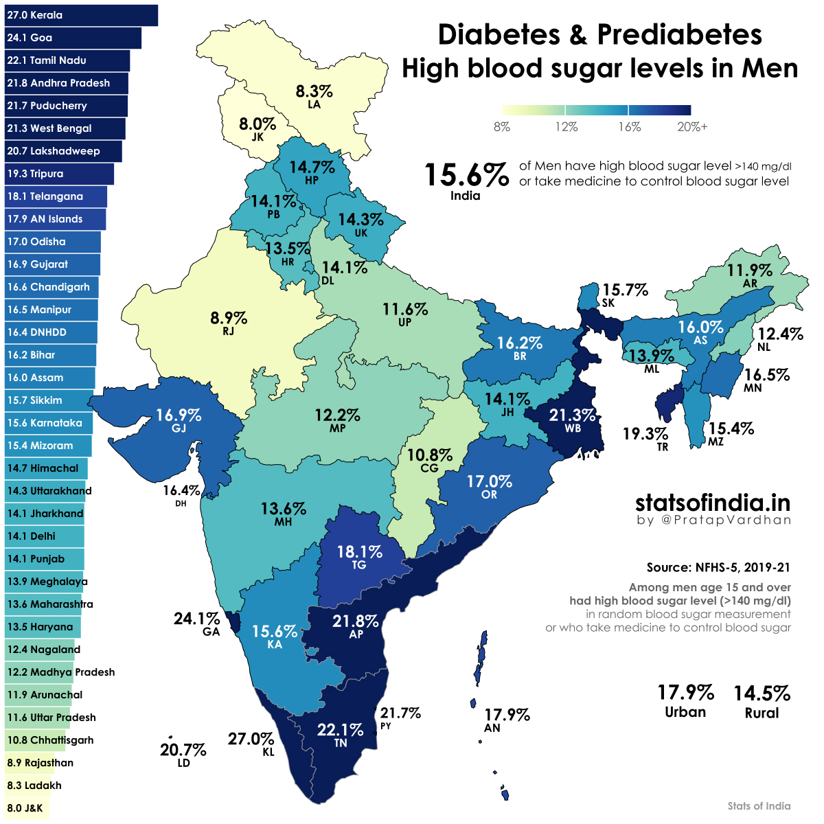
With AI reference info- https://bard.google.com
Notes:
https://www.chameleon-pharma.com/services/pharma-regulatory-registration/Diabetes-regulatory-affairs/

Slide 12
Brandex (Sitagliptin + Metformin)
4. STRATEGY FOR MAHARASHTRA

Slide 13

2. HIGHEST PREVELACE OF DIABETES IN MAHARASHTRA
.
Cities in Maharashtra with the highest prevalence of diabetes according to a recent search
Mumbai
Nanded
With AI reference info- https://bard.google.com/
Notes:
https://www.chameleon-pharma.com/services/pharma-regulatory-registration/Diabetes-regulatory-affairs/

Slide 14
Brandex (Sitagliptin + Metformin)
5. COMPETITOR PRICE ANALYSIS

Slide 15
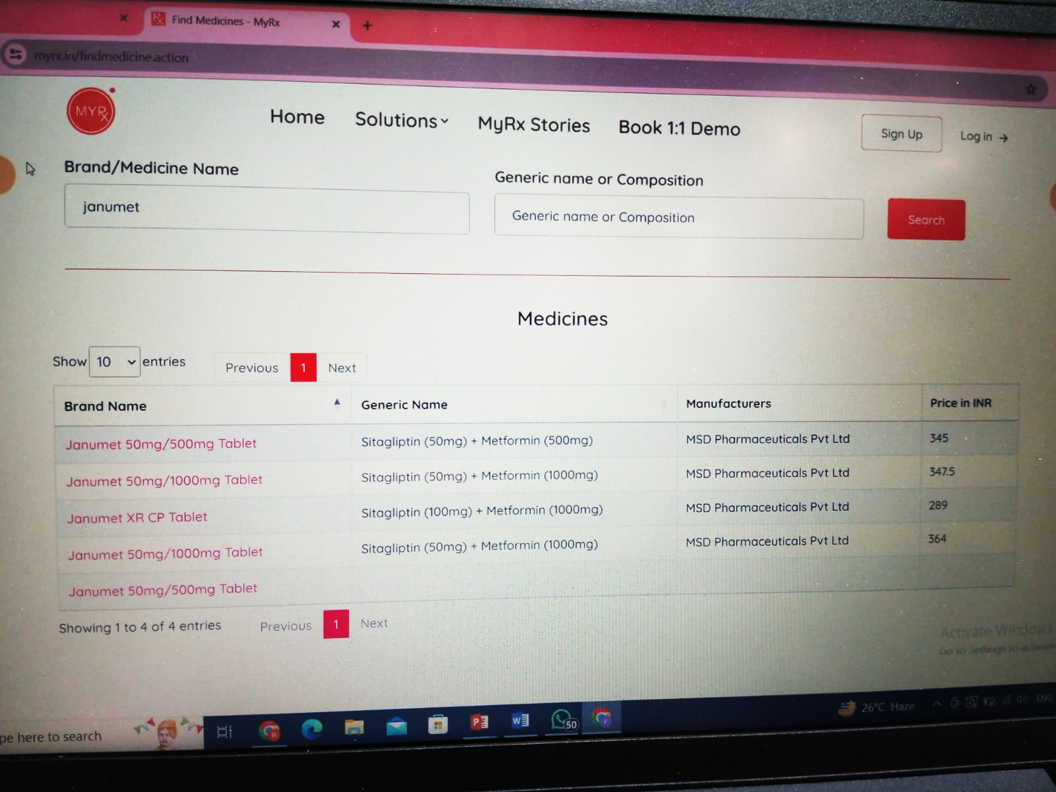
1. Competitor price analysis
https://myrx.in/findmedicine.action
Notes:
https://www.chameleon-pharma.com/services/pharma-regulatory-registration/Diabetes-regulatory-affairs/

Slide 16
Brandex (Sitagliptin + Metformin)
6. FINDING USP

Slide 17
1. Determining USP
Janumet is a medication with a large potential market in India.
The growing diabetes market in India, coupled with the increasing awareness of diabetes and the rising disposable incomes, is expected to drive the demand for Janumet in the coming years.
However, Janumet is a relatively expensive medication, so it is important to focus on targeting patients with higher incomes and insurance coverage.
So price could be our USP
With other factors such as:-
Quality
Availability
Trust
With AI reference info- https://bard.google.com/
https://myrx.in/findmedicine.action
Notes:
https://www.chameleon-pharma.com/services/pharma-regulatory-registration/Diabetes-regulatory-affairs/

Slide 18
Brandex (Sitagliptin + Metformin)
7. EVALUATE BRAND HEALTH

Slide 19
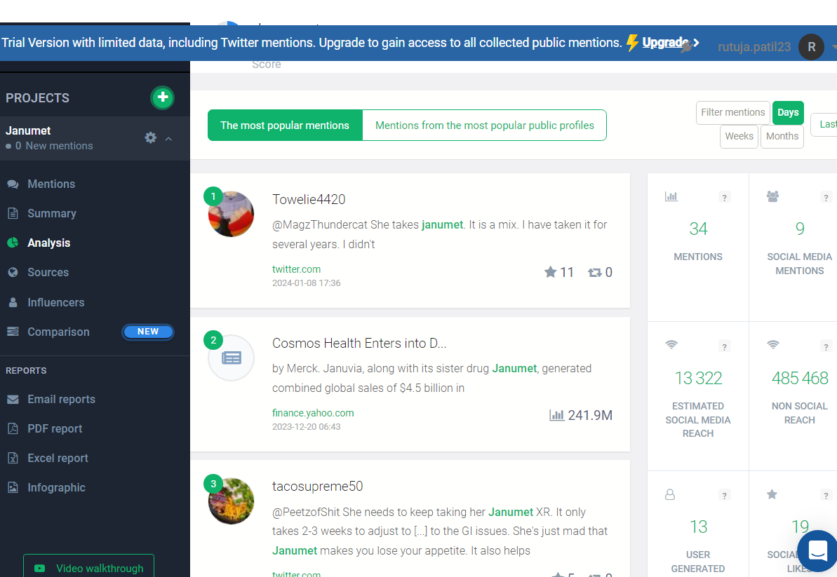
1. BRAND HEALTH EVALUATION
SNAPSHOT
Traditionally- Conducting Surveys & Gathering feedback manually
With AI & Apps- Youscan & Brand24 uses AI to give a comphrensive view of your brand health analyzing overall review and perception based on real time.
https://app.brand24.com/user/login/?backurl=%2Fpanel%2Fresults%2F%3Fsid%3D1208051440%26utm_medium%3Demail%26utm_source%3Ddaily_report%26utm_content%3Dheader_cta
Notes:
https://www.chameleon-pharma.com/services/pharma-regulatory-registration/Diabetes-regulatory-affairs/

Slide 20
Brandex (Sitagliptin + Metformin)
8. DATA ANALYSIS FOR SALES AND MARKETING

Slide 21
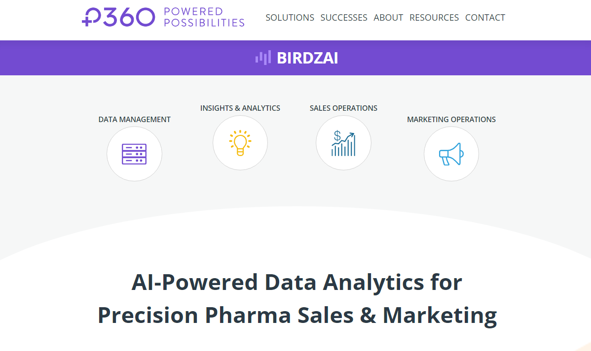
1. PHARMACEUTICAL PRODUCT DATA ANALYSIS
AI-Powered Data Analytics for Precision Pharma Sales & Marketing
Managing data :
Managing Modern Data Estate with BirdzAI Platform
Insight and analytics:
building a journey from data to decisions with ai
Sales operation :
power your sales teams with a faster, more efficient sales process
Marketing operation :
build and operate your omnichannel marketing strategy
https://www.p360.com/birdzai/
https://adoption.microsoft.com/en-us/project-sophia/
Notes:
https://www.chameleon-pharma.com/services/pharma-regulatory-registration/Diabetes-regulatory-affairs/

Slide 22
Brandex (Sitagliptin + Metformin)
9. MANAGING DAY TO DAY ACTIVITY OF SALES TEAM

Slide 23
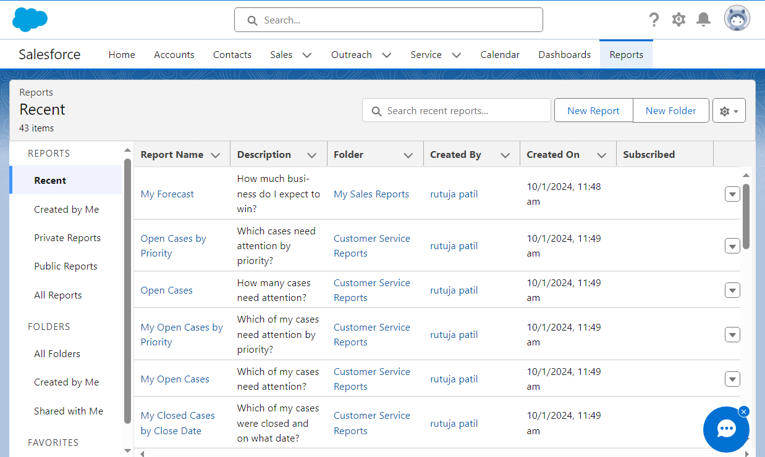
1. Sales force managing
Salesforce helps businesses keep track of customer interactions and sales data.
It can manage leads, contacts, opportunities, and cases.
Salesforce also offers several features to help businesses automate their sales and marketing processes,
such as email marketing, lead capture, and lead scoring.
https://flow-dream-6897.lightning.force.com/lightning/page/home
Notes:
https://www.chameleon-pharma.com/services/pharma-regulatory-registration/Diabetes-regulatory-affairs/

Slide 24
Brandex (Sitagliptin + Metformin)
10. SALES TRAINING

Slide 25

1. INTERACTION WITH CUSTOMER
Briefly discuss the significance of personal selling in today's highly competitive marketing environment. How would you meet sales resistance in the following situation as a Medical Representative?
A sincere objection raised by the doctor about the high price of your drug
An insincere objection relating to the shape of the bottle in which your cough syrup is being sold.
With AI & Apps- https://chat.openai.com/
With AI reference info- https://bard.google.com/
Notes:
https://www.chameleon-pharma.com/services/pharma-regulatory-registration/Diabetes-regulatory-affairs/

Slide 26
1. TRAINING OF SALES PEOPLE
One on one conversation with chatbot.ai could help Medical-Rep
to improve the interaction part and understanding the core concepts to work upon.
Developing or forming an questionnaire could help Med-Rep to come up with a developed approaching strategy
With AI & Apps- https://chat.openai.com/
With AI reference info- https://bard.google.com/
Notes:
https://www.chameleon-pharma.com/services/pharma-regulatory-registration/Diabetes-regulatory-affairs/

Slide 27
1. How I Generated ANS
1. High Price Objection -
Acknowledge: Begin by acknowledging the doctor's concern and expressing understanding. You might
say, "I appreciate your concern about the price, doctor."
- Value Proposition: Highlight the unique value proposition of your drug. Emphasize its effectiveness, quality, and any additional benefits that justify the price. Provide evidence such as clinical studies or testimonials.
- Cost-Benefit Analysis: Help the doctor understand the long-term benefits and potential cost savings for patients. Illustrate how the efficacy and features of your drug can contribute to better patient outcomes, ultimately justifying the investment.
- Offer Solutions: If possible, explore options such as discounts, bulk purchase incentives, or trial samples to ease the financial burden on the doctor's practice.
In situations like these, the key is to listen actively, address objections with empathy, and focus on the unique selling points of your product. Building a positive and collaborative relationship with the doctor can contribute to overcoming sales resistance and securing their endorsement of your pharmaceutical product.
With AI & Apps- https://chat.openai.com/
Notes:
https://www.chameleon-pharma.com/services/pharma-regulatory-registration/Diabetes-regulatory-affairs/

Slide 28
Brandex (Sitagliptin + Metformin)
10. SALES TRAINING ABOUT THE PRODUCT

Slide 29
Introduction:
Briefly introduce the drug and its generic name (sitagliptin).
Provide a quick overview of the therapeutic class (e.g., Dipeptidyl peptidase-4 (DPP-4) inhibitors).
Indications:
Clearly state the approved indications for the drug.
Highlight conditions or diseases for which sitagliptin is proven to be effective.
Mechanism of Action:
Explain how sitagliptin works in the body. Focus on its mechanism of action as a DPP-4 inhibitor, which helps regulate blood sugar levels.
Efficacy and Clinical Studies:
Summarize key clinical studies supporting the efficacy of sitagliptin.
Include relevant data on its impact on glycemic control, patient outcomes, and any comparative studies with other treatments.
Dosage and Administration:
Provide clear and concise information on recommended dosage.
Explain the administration guidelines, including whether it should be taken with or without food and any specific considerations.
Safety Profile:
Present information on the safety profile, including common and serious side effects.
Discuss contraindications and precautions, such as specific patient populations to avoid.
Drug Interactions:
Highlight potential drug interactions with other commonly prescribed medications.
Emphasize the importance of reviewing patients' current medication regimens to avoid adverse effects.
Patient Counseling:
Include key points for healthcare providers to discuss with patients, such as adherence to treatment, monitoring blood sugar levels, and recognizing signs of adverse reactions.
Market Positioning:
Provide information on how the drug positions itself in the market compared to other similar medications.
Discuss any unique features or advantages that make it a preferred choice.
Promotional Materials and Samples:
Showcase any available promotional materials, such as brochures or pamphlets, that medical representatives can use in their interactions with healthcare professionals.
Mention if there are samples available for distribution.
Q&A and Discussion:
Allocate time for questions and answers to address any queries or concerns medical representatives might have.
Encourage an open discussion to enhance understanding and confidence in promoting the drug.

Slide 30

1. Sales training material preparation
AI-Powered presentation making
Effortless Creation from the Ground Up
Design That Shines
The Art of Concise Communication
Interactivity that Captivates
Seamless Engagement and Collaboration
https://gamma.app/?lng=en
Notes:
https://www.chameleon-pharma.com/services/pharma-regulatory-registration/Diabetes-regulatory-affairs/

Slide 31

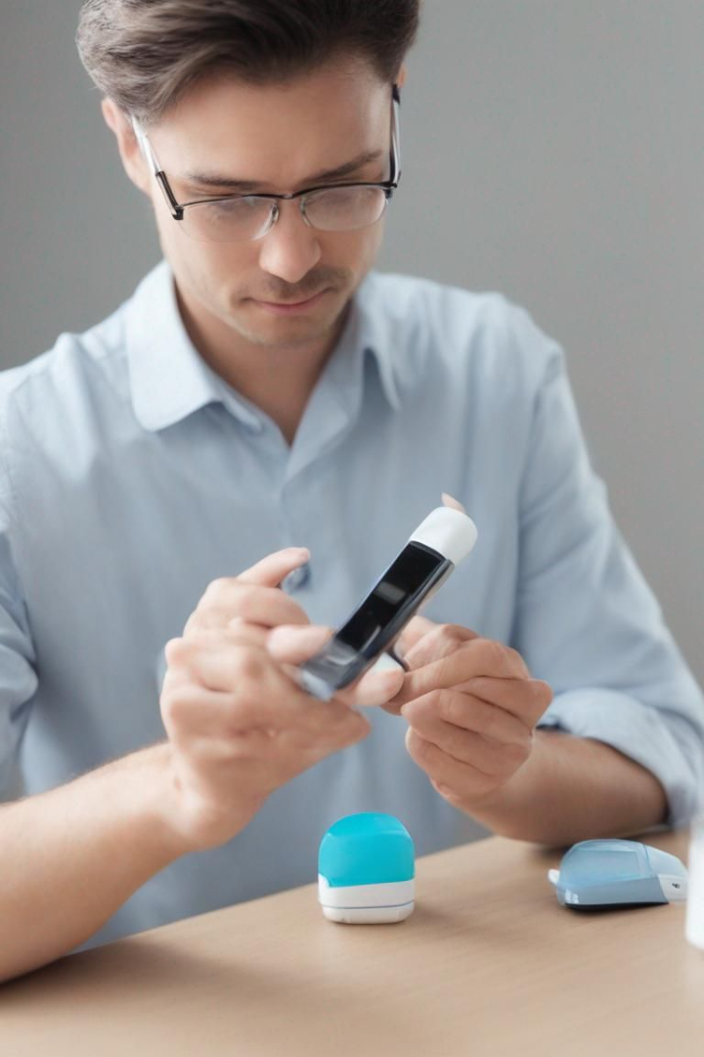
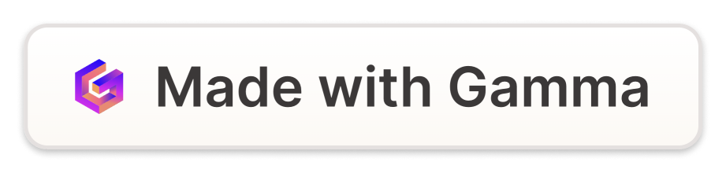
Introduction to Sitagliptin Product
Sitagliptin is a medication used to treat type 2 diabetes. It belongs to a class of drugs known as dipeptidyl peptidase-4 (DPP-4) inhibitors, which work by increasing the levels of incretin hormones in the body, ultimately reducing blood sugar levels.

Slide 32

Safety Profile
1
Tolerability
2
Risk Mitigation
Sitagliptin has demonstrated a generally favorable safety profile, with a low incidence of adverse events in clinical studies.
The medication's safety has been well-established through extensive post-marketing surveillance and real-world patient experiences.
3
Common Side Effects
Common side effects include upper respiratory tract infection, headache, and nasopharyngitis, generally being mild to moderate in nature.

Slide 33

Indications and Approved Uses
Primary Indication
Monotherapy or Add-on
Renal Impairment
Sitagliptin is indicated as an adjunct to diet and exercise to improve glycemic control in adults with type 2 diabetes mellitus.
The dosage of Sitagliptin may need to be adjusted based on the patient's renal function, ensuring safe and effective use.
It can be used as monotherapy or in combination with other antidiabetic medications, offering flexibility in treatment strategies.

Slide 34
Safety Profile
1
Tolerability
2
Risk Mitigation
Sitagliptin has demonstrated a generally favorable safety profile, with a low incidence of adverse events in clinical studies.
The medication's safety has been well-established through extensive post-marketing surveillance and real-world patient experiences.
3
Common Side Effects
Common side effects include upper respiratory tract infection, headache, and nasopharyngitis, generally being mild to moderate in nature.

Slide 35
Indications and Approved Uses
Primary Indication
Monotherapy or Add-on
Renal Impairment
Sitagliptin is indicated as an adjunct to diet and exercise to improve glycemic control in adults with type 2 diabetes mellitus.
The dosage of Sitagliptin may need to be adjusted based on the patient's renal function, ensuring safe and effective use.
It can be used as monotherapy or in combination with other antidiabetic medications, offering flexibility in treatment strategies.

Slide 36
Dosage and Administration
100 mg
50 mg
Standard Dose
Renal Impairment
The recommended initial dose of Sitagliptin is 100 mg once daily, with or without food, for most patients.
For patients with moderate or severe renal impairment, a lower dosage of 50 mg once daily is recommended.

Slide 37
Key Scientific Evidence Supporting Sitagliptin
Clinical Efficacy
Proven reduction in HbA1c levels and positive impact on long-term glycemic control.
Safety Data
Extensive safety data from studies and real-world use, reinforcing the medication's favorable safety profile.
Mechanism Insights
Scientific understanding of the DPP-4 inhibition mechanism, shedding light on its unique mode of action.

Slide 38




Conclusion and Key Takeaways
Effective Management
Sitagliptin offers effective glycemic control, reducing the risk of diabetes-related complications.
Well-Established Safety
The medication's safety and tolerability have been well-established through rigorous clinical trials and real-world use.
Treatment Flexibility
Its flexible dosing and combination options provide tailored approaches to meet patient needs and preferences.

Slide 39

Promotional Material and Samples
Explore the range of promotional materials available and the provision of samples for healthcare professionals to gain insights into the product.

Slide 40

Market Positioning
Competitive Edge
Physician Engagement
Sitagliptin's unique mechanism and well-documented efficacy place it in a strong position within the diabetes treatment landscape.
Strategies for engaging healthcare providers and ensuring informed prescribing decisions to optimize patient care.
Access and Awareness
Efforts to enhance access to Sitagliptin for patients and raise awareness about its benefits and appropriate use.

